Slide 1

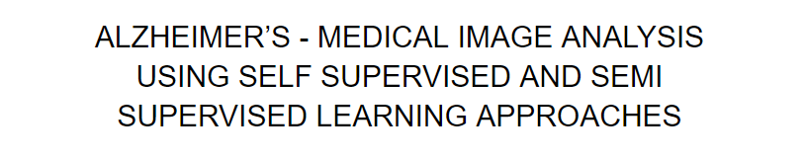
CMPE 297 - PROJECT PRESENTATION
ABHISHEK BAIS, HALEY FENG, PRINCY JOY, SHANNON PHU GRADUATE STUDENTS, SOFTWARE ENGINEERING, SJSU

Slide 2
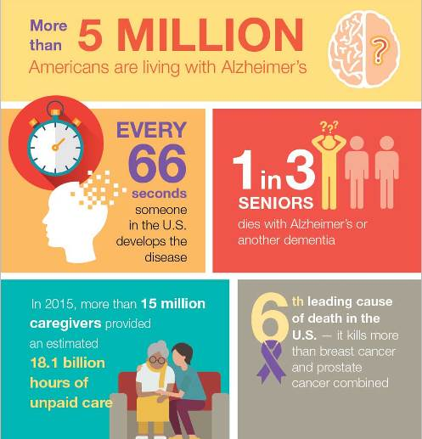
ALZHEIMER’S
WHAT IS IT?
IN NUMBERS?
A progressive, degenerative brain cell disease that affects memory and mental function
Pic Credit: Mayo Clinic Health System
ALZHEIMER’S ASSOCIATION REPORT:
EARLY DIAGNOSIS CAN SAVE $7 TRILLION IN COSTS

Slide 3
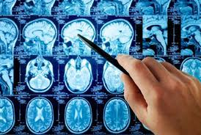
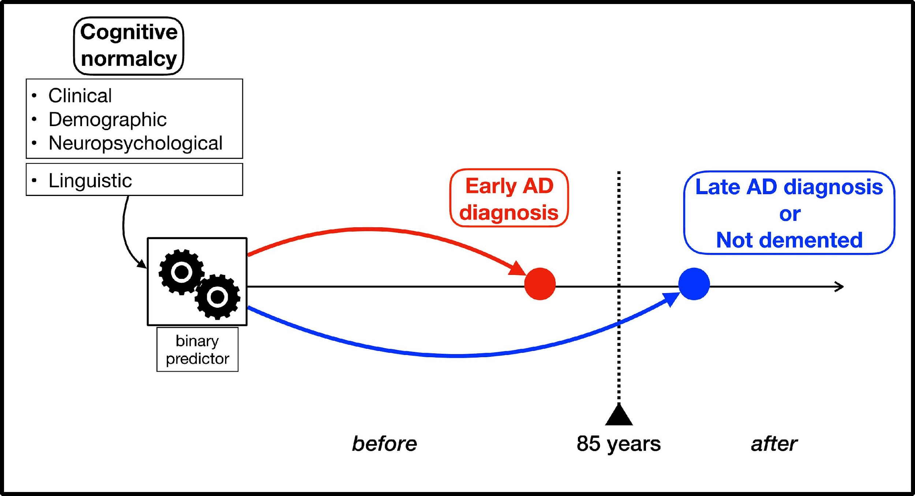
TRADITIONAL METHODS OF EARLY ALZHEIMER’S DETECTION
NEUROADIOLOGISTS MONITORING LESIONS
LINGUISTIC COGNITIVE NORMALCY TESTS

Slide 4
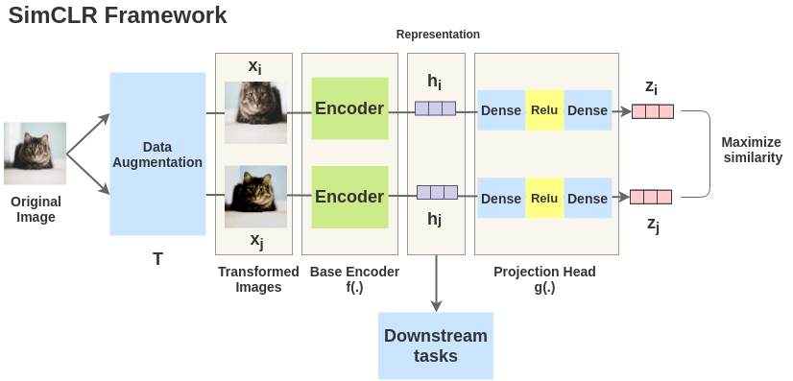

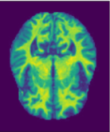
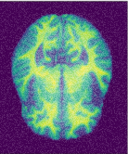
SELF SUPERVISED CONTRASTIVE LEARNING VIA SIMCLR
Pic Credits: The illustrated SimCLR framework

Slide 5
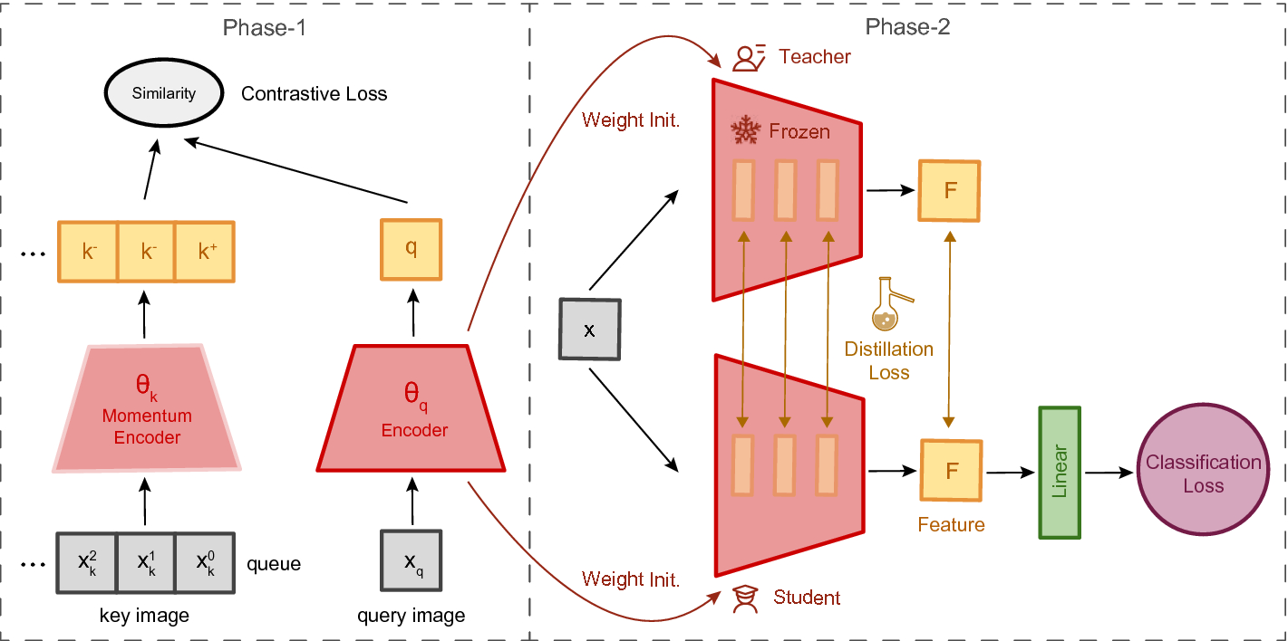
SEMI SUPERVISED LEARNING USING SIMCLRV2
SELF SUPERVISED SIMCLR
SEMI SUPERVISED TUNING FOLLOWED BY KNOWLEDGE DISTILLATION FROM TEACHER TO STUDENT
Pic Credits: Distilling visual priors from self supervised learning

Slide 6
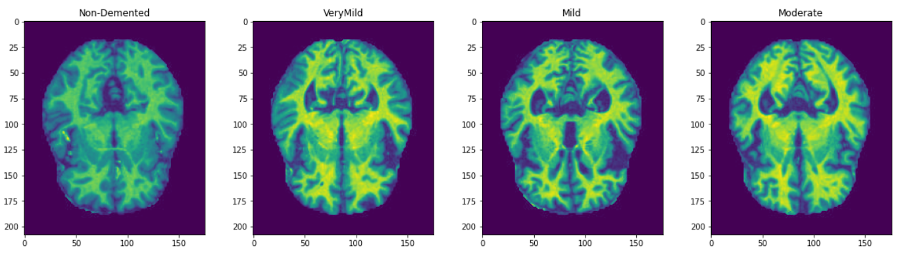
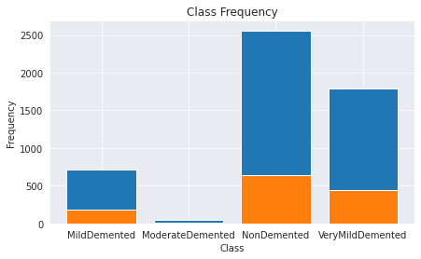
KAGGLE DATASET
FOUR DIFFERENT STAGES OF ALZHEIMER’S
Training: 5121, Testing: 1279

Slide 7
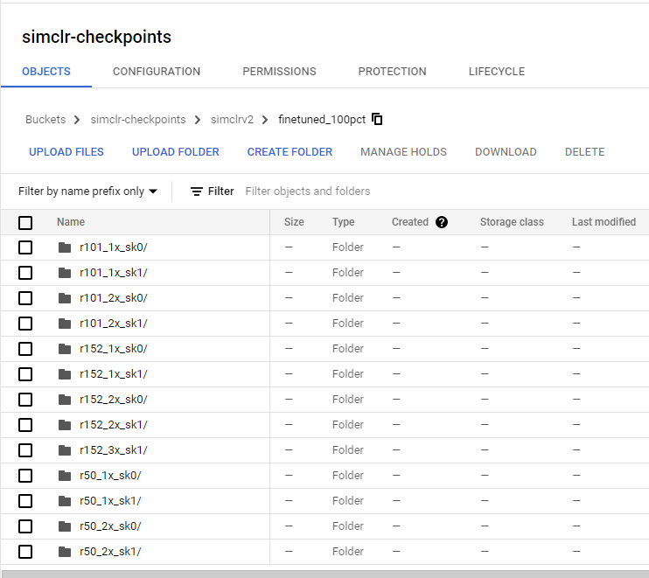
PRETRAINED MODEL – FINE TUNED SIMCLR MODEL R50_1X_SK0 TRAINED ON 100% IMAGENET

Slide 8
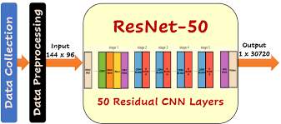
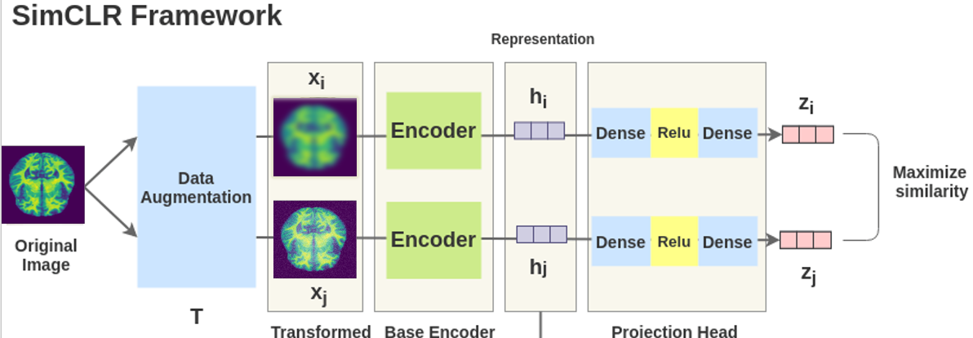
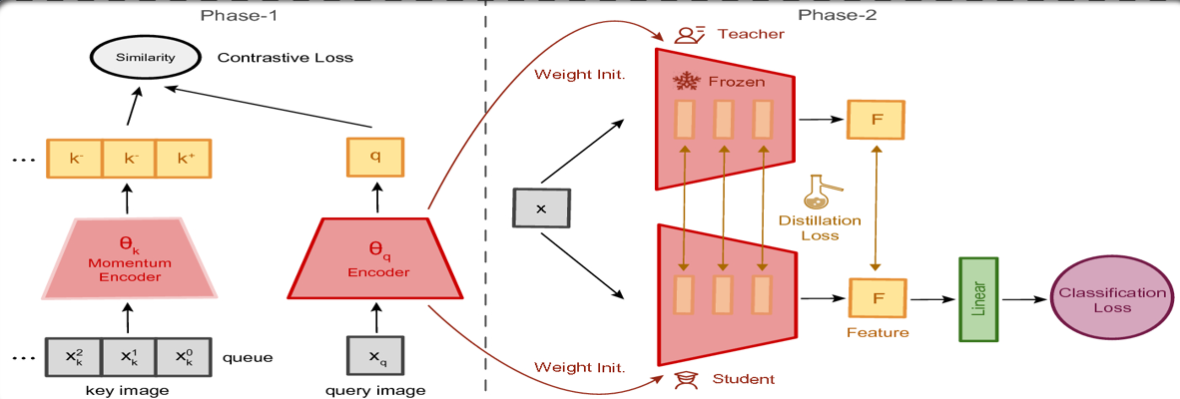
METHODOLOGY – COMPARE AND CONTRAST RESULTS FOR EXPERIMENTS 1- 3, PICK BEST MODEL
EXPERIMENT 1
EXPERIMENT 2
EXPERIMENT 3
TRAIN SIMCLR RESNET50 ON 1% IMAGENET, FINE TUNE ON ALZHEIMER’S IMAGES
USE PRE-TRAINED SIMCLR ON 100% IMAGENET, FINE TUNE ON ALZHEIMER’S IMAGES
USE PRE-TRAINED SIMCLR ON 100% IMAGENET, PERFORM KNOWLEDGE DISTILLATION USING ALZHEIMER’S IMAGES

Slide 9
Model Configuration
Evaluation Metric
Optimizer | RMSProp Adam LARS
Loss Function | Cross Entropy
Activation | Softmax
Learning Rate Scheduler | Exponential Decay Cosine Decay Step Decay
Early Stopping | Yes
Batch Size | 16, 32, 64
Accuracy | Sample matching exactly as the ground truth. Best value at 1 and worst score at 0.
F1-Score | A harmonic mean of the precision and recall. Best value at 1 and worst score at 0.
Precision-Recall Curve | Import to consider for an imbalance dataset High precision = low false positive rate High recall = low false negative rate High scores for both means model returns accurate results and a majority of all positive results
AUC-ROC Curve | Ideal point at the top left corner of the plot a false positive rate of zero, and a true positive rate of one The area under the curve (AUC) shows how well the model is capable of distinguishing between classes

Slide 10
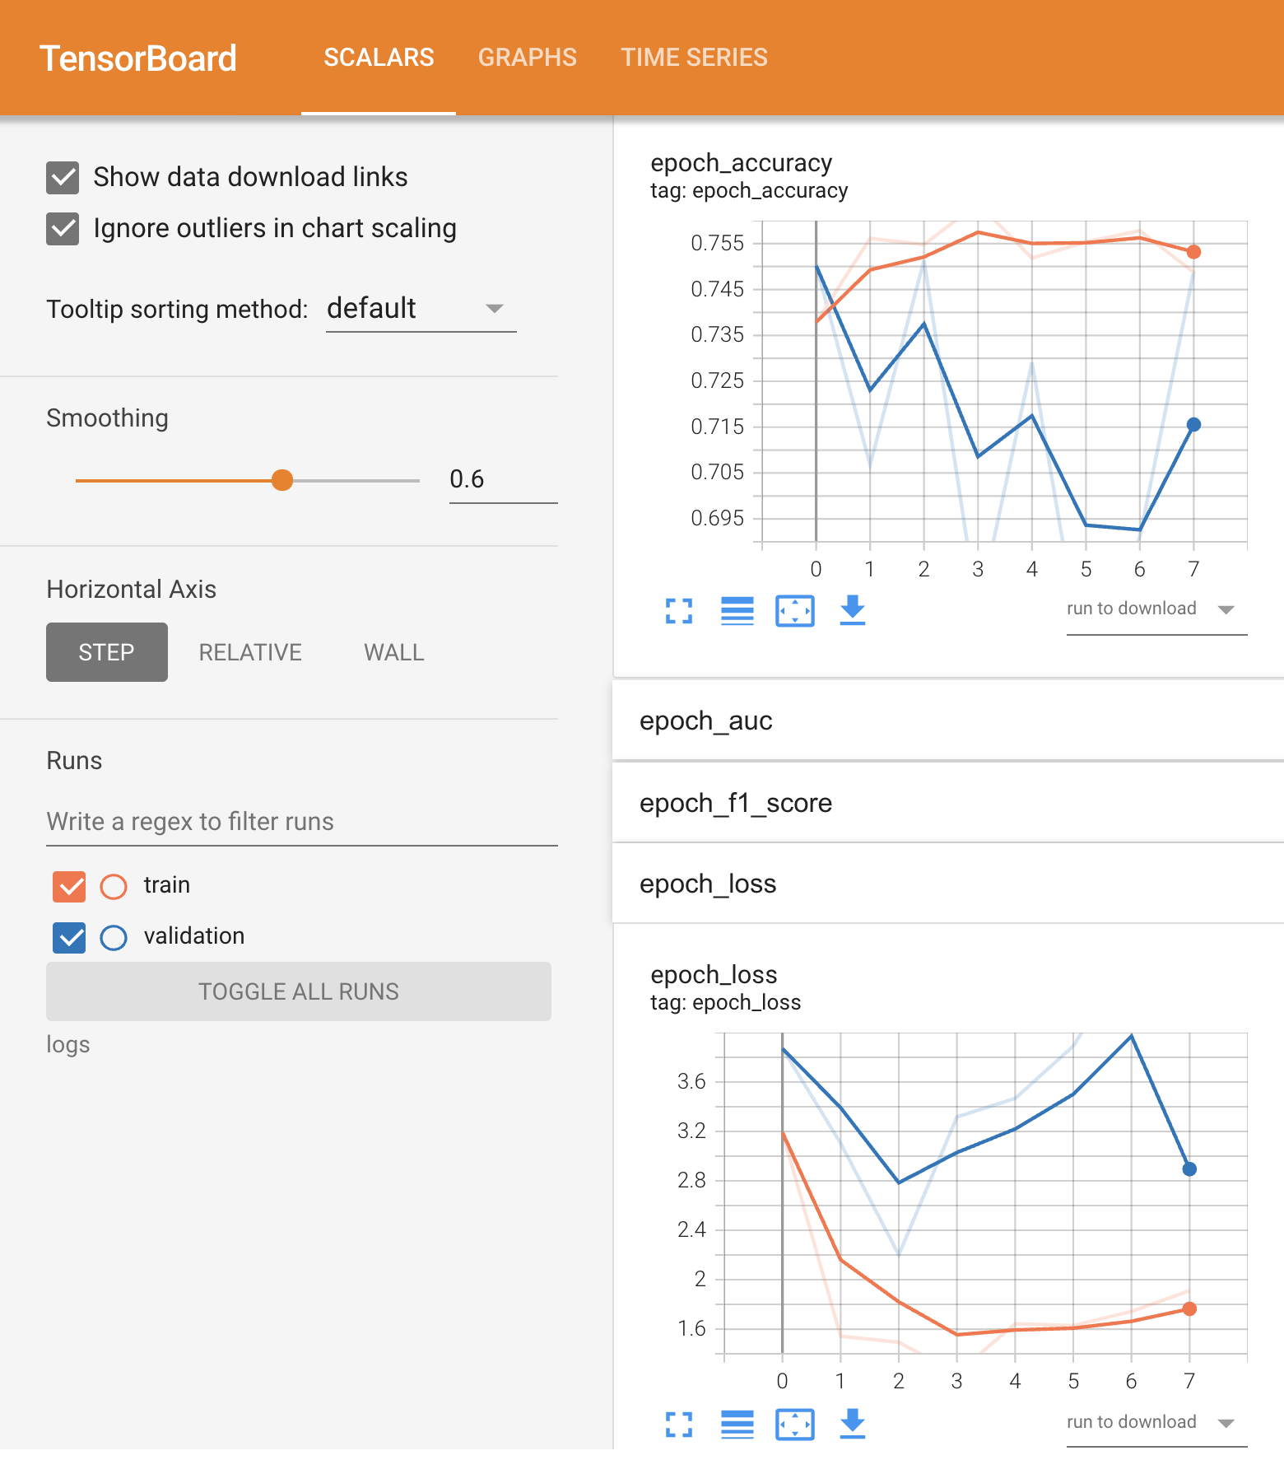
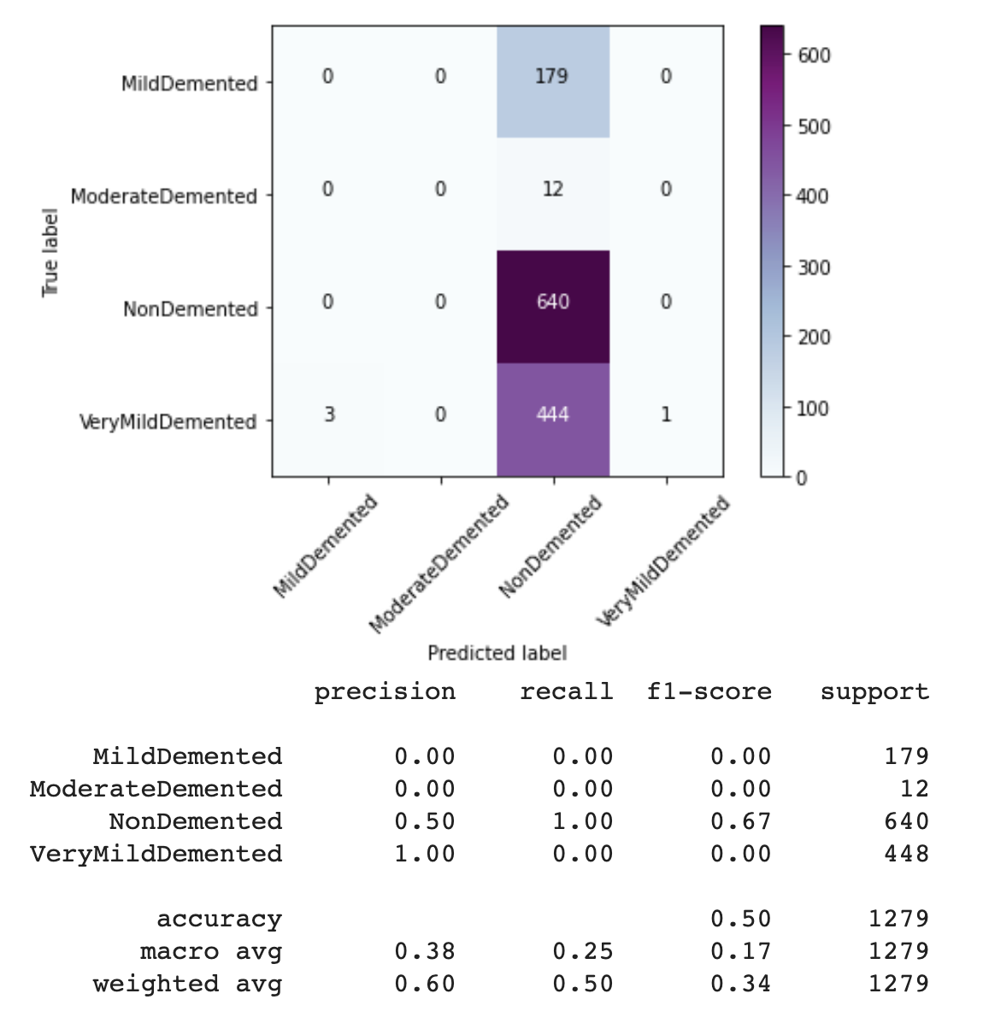
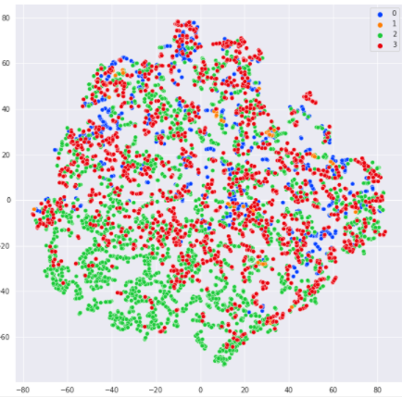
RESULTS – SIMCLR RESNET 50 WITH NON-LINEAR PROJECT HEAD
Weights and Bias Directory: Used to run experiments, save/ restore models

Slide 11
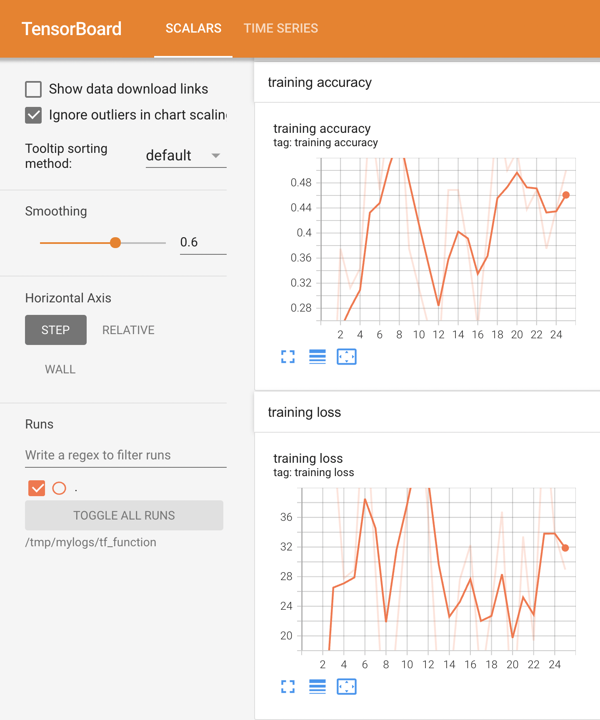

RESULTS – PRETRAINED SIMCLR WITH SIMCLRV2 ON ALZHEIMER IMAGES

Slide 12
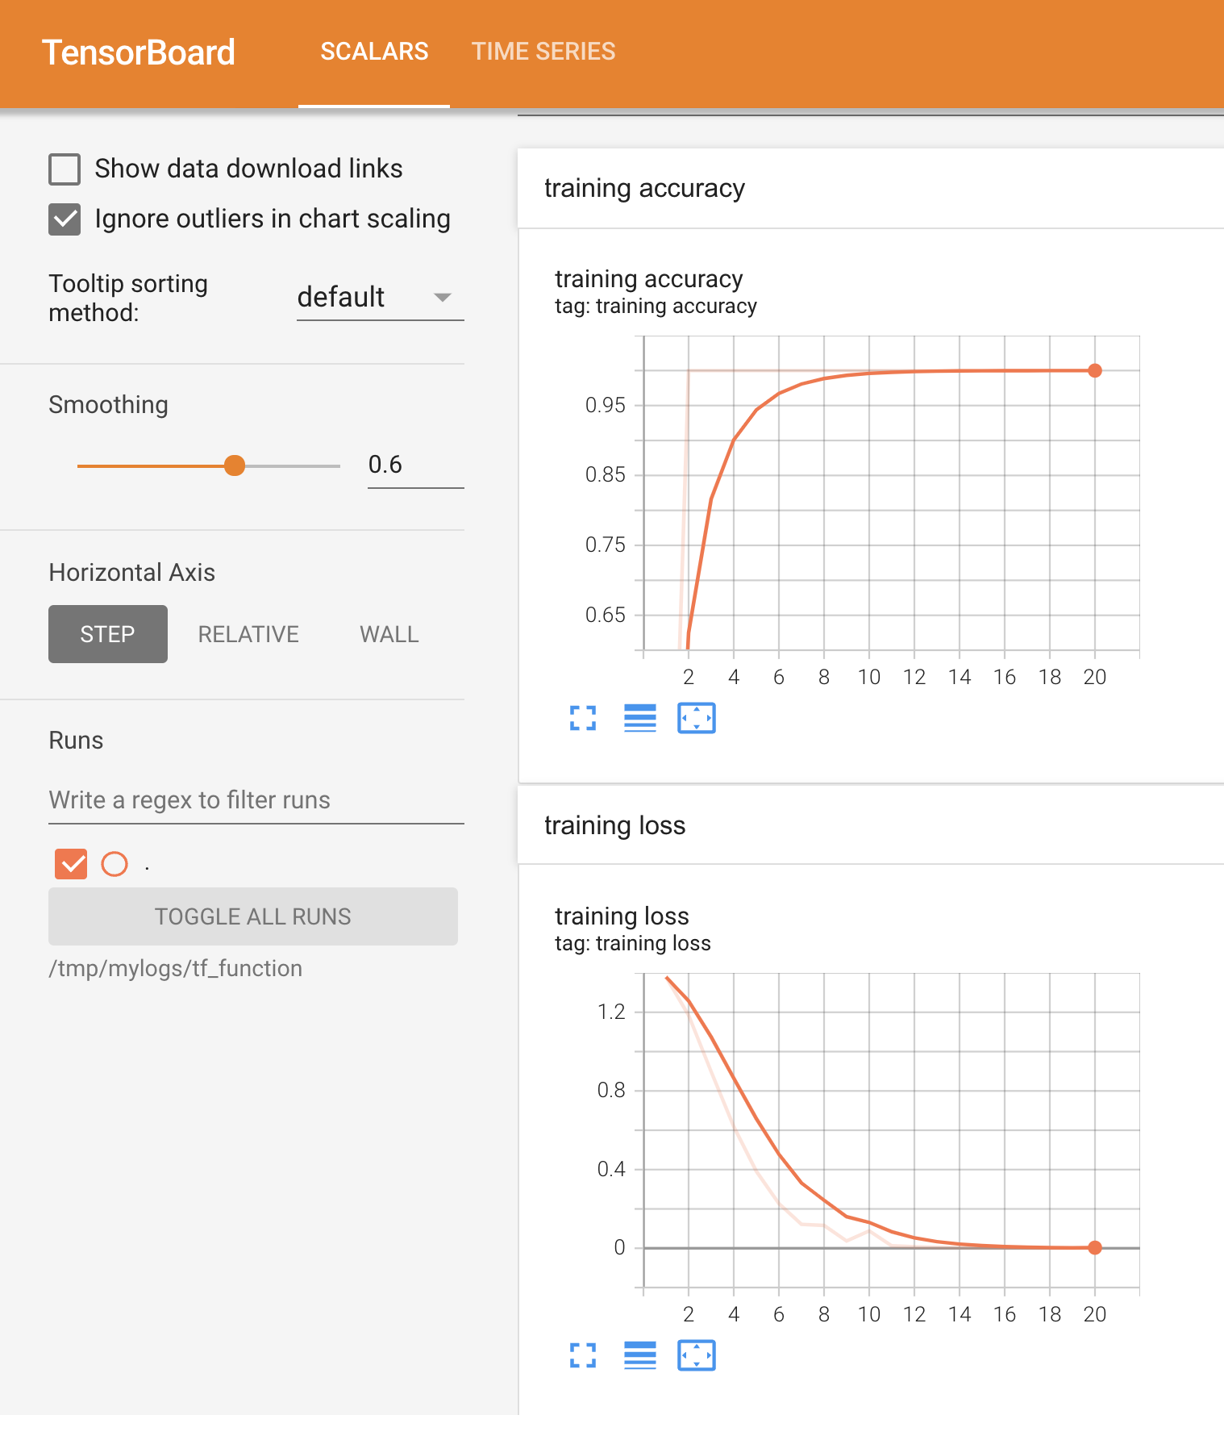
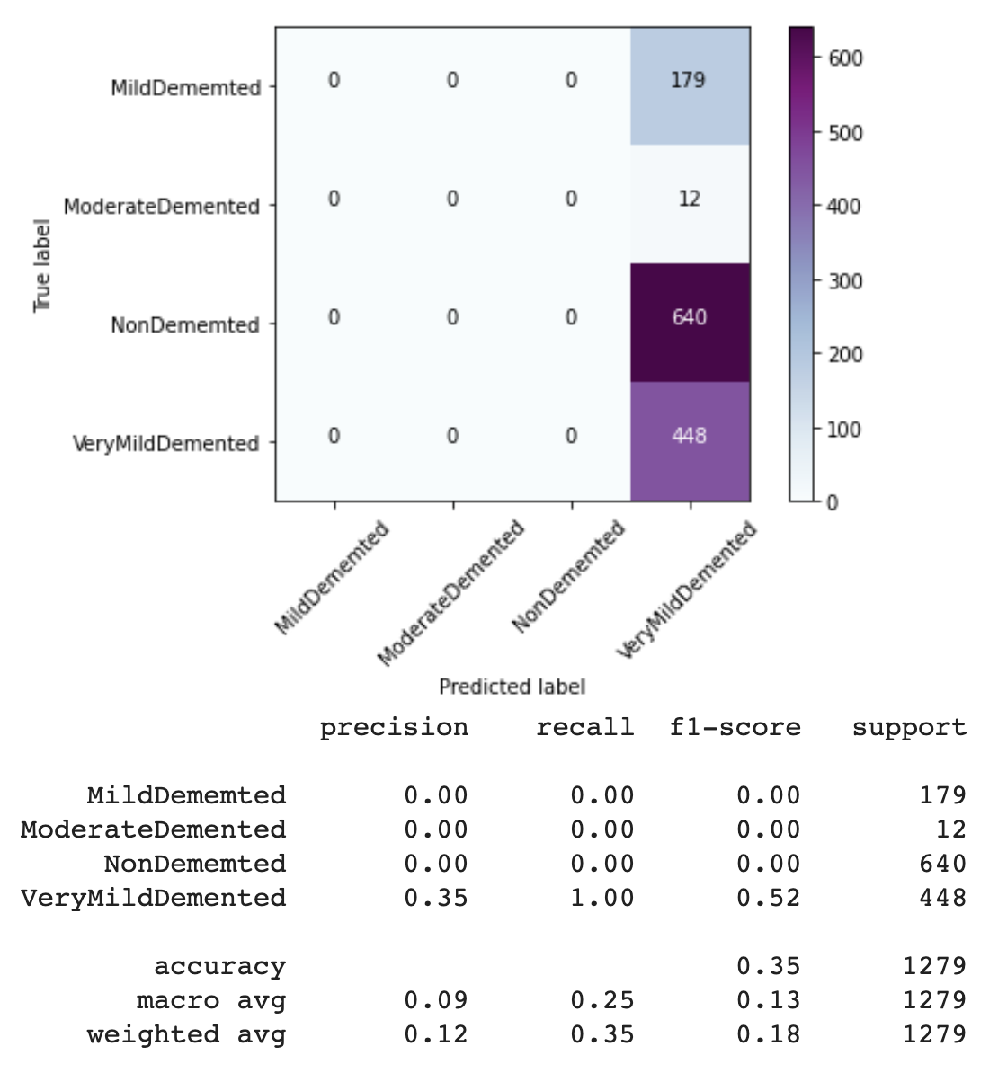
RESULTS – PRETRAINED SIMCLR WITH SIMCLRV2 KNOWLEDGE DISTILLATION ON ALZHEIMER IMAGES

Slide 13
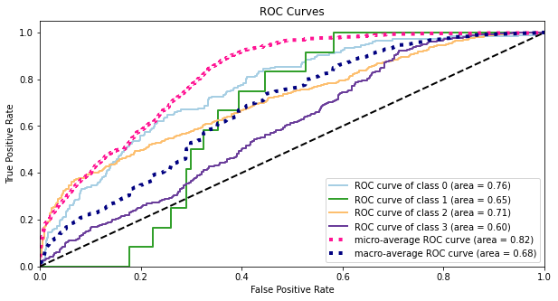
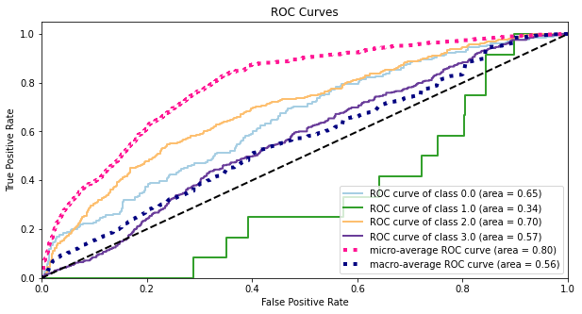
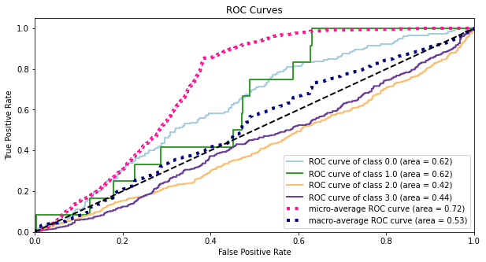
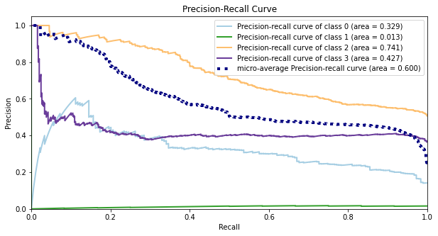
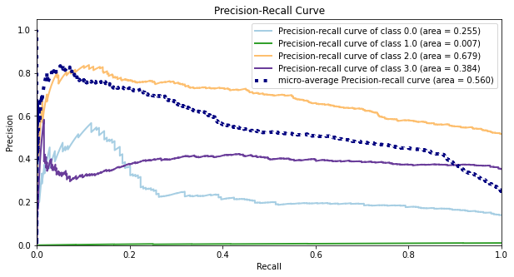
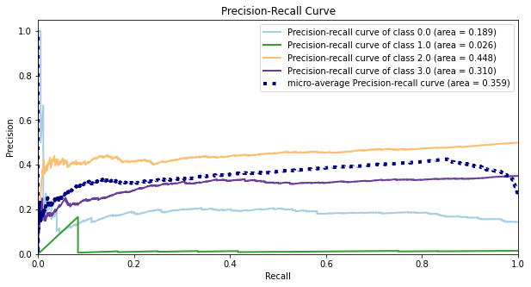
METHODOLOGY COMPARISONS
SIMCLR V1
SIMCLR V2
(Fine-tuned On Alzheimer)
SIMCLR V2
(Distillation to Student)

Slide 14
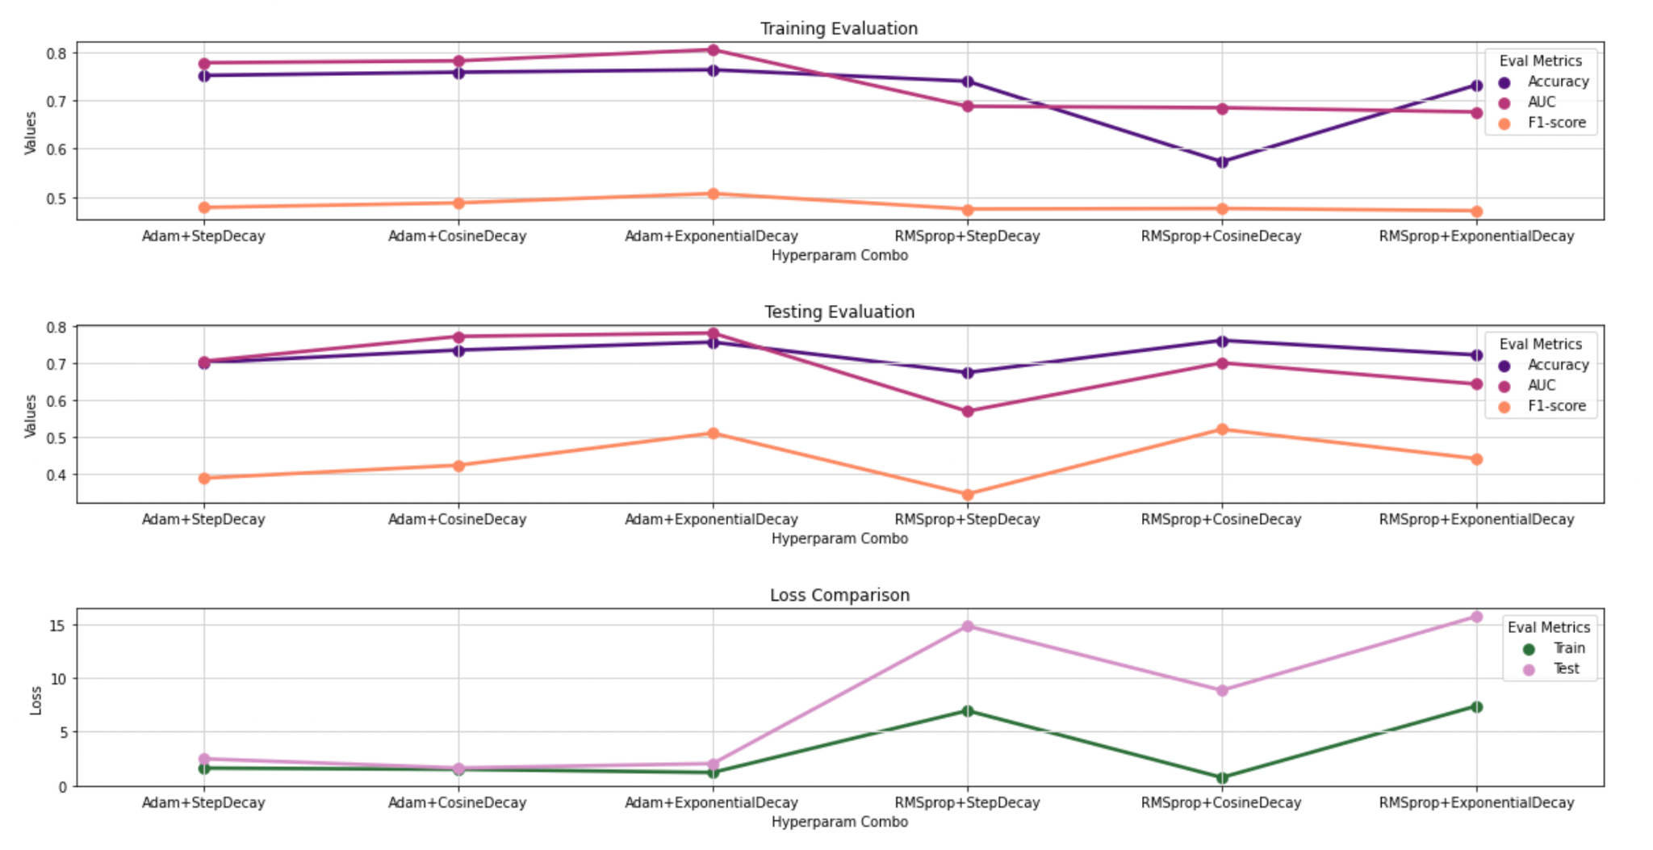
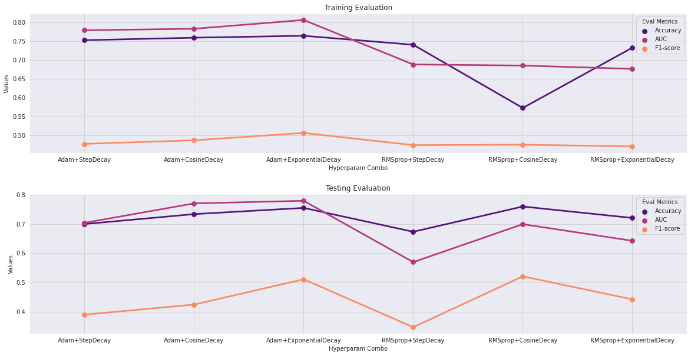
HYPERPARAMETER TUNING COMPARISON ON SIMCLR RESNET 50 WITH NON-LINEAR PROJECT HEAD

Slide 15
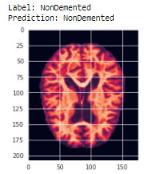
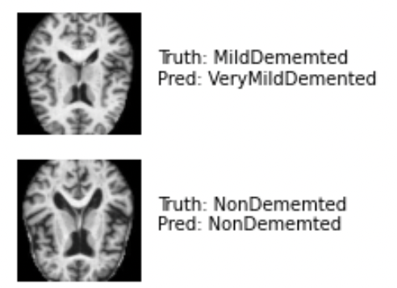
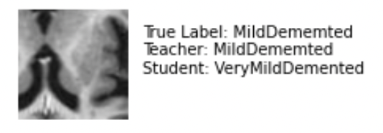
RESULTS – PREDICTION ON SAMPLE IMAGES
EXPERIMENT 1
EXPERIMENT 2
EXPERIMENT 3
TRAIN SIMCLR RESNET50 ON 1% IMAGENET, FINE TUNE ON ALZHEIMER’S IMAGES
USE PRE-TRAINED SIMCLR ON 100% IMAGENET, PERFORM KNOWLEDGE DISTILLATION USING ALZHEIMER’S IMAGES
USE PRE-TRAINED SIMCLR ON 100% IMAGENET, FINE TUNE ON ALZHEIMER’S IMAGES

Slide 16

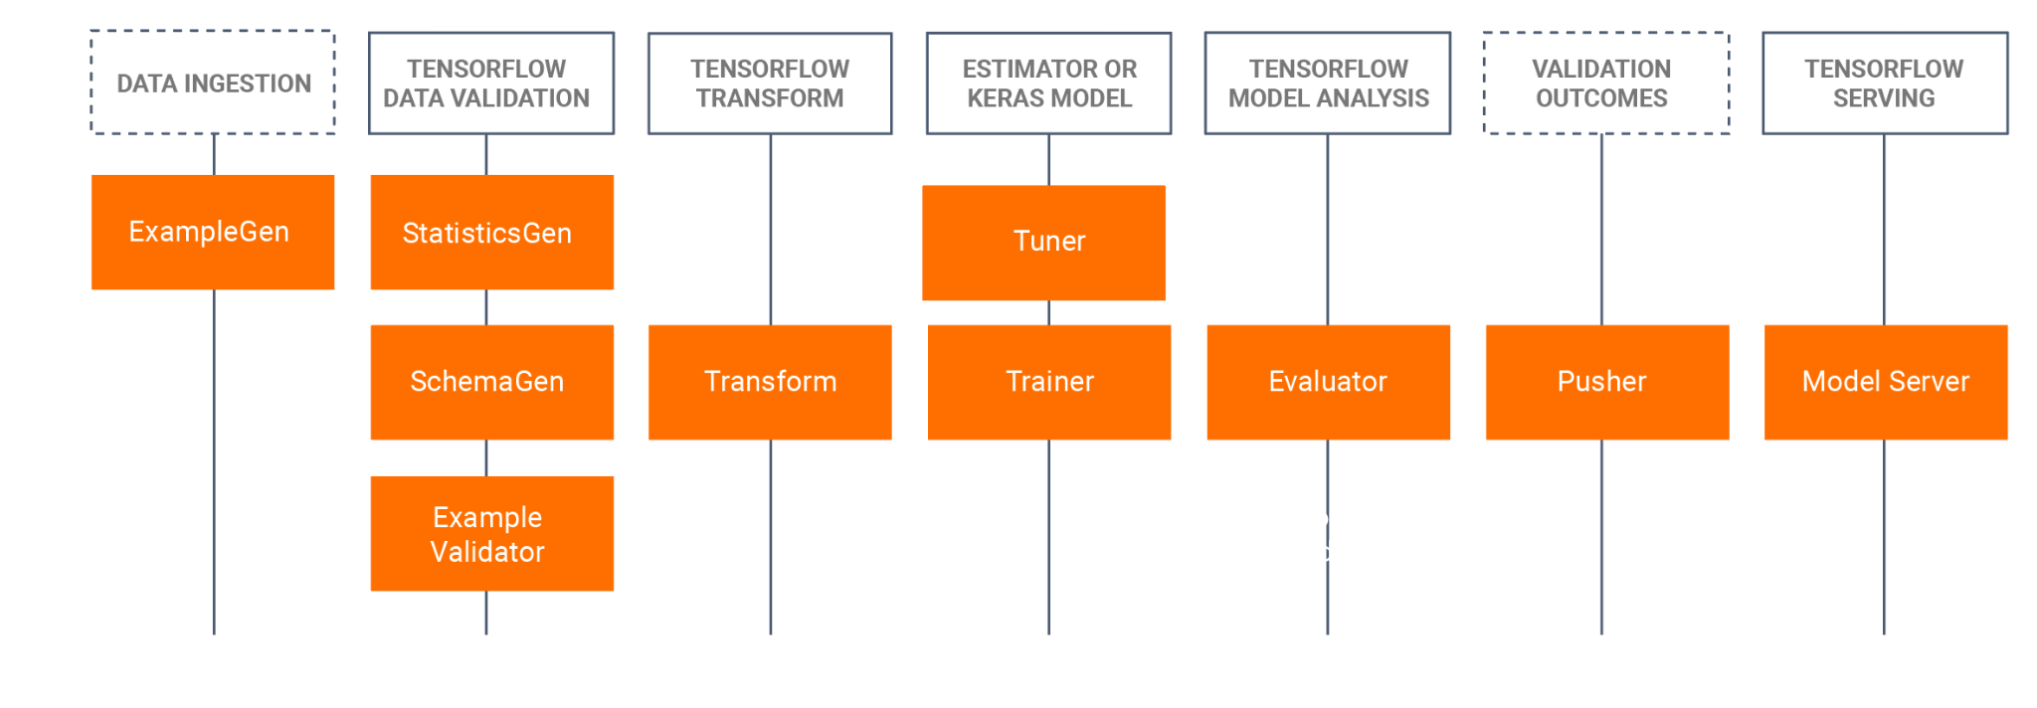
MLOPS WITH TFX & KUBEFLOW

Slide 17
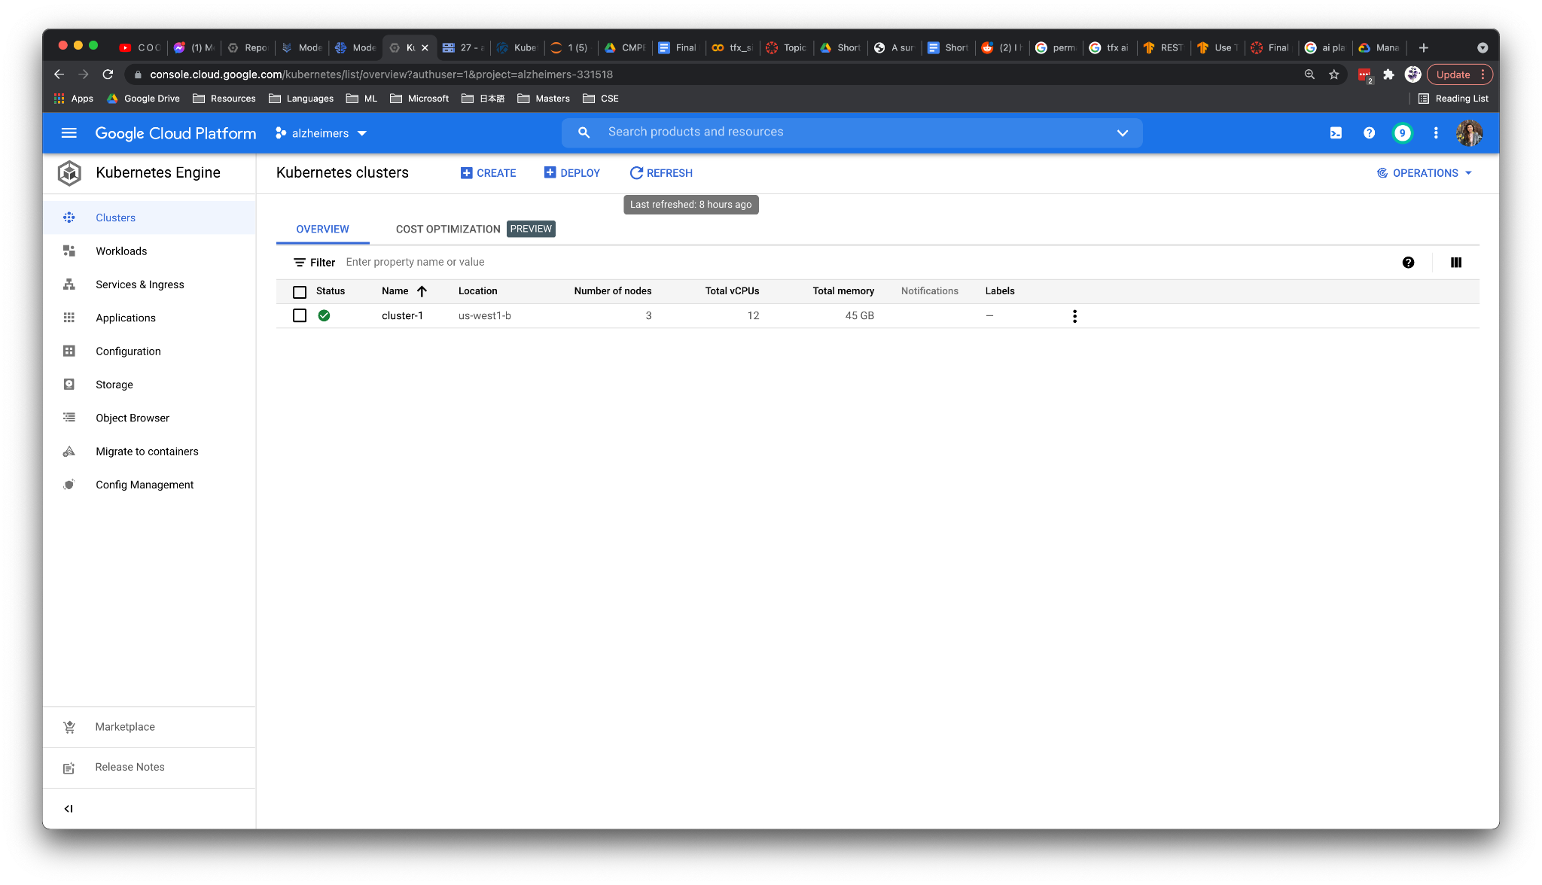
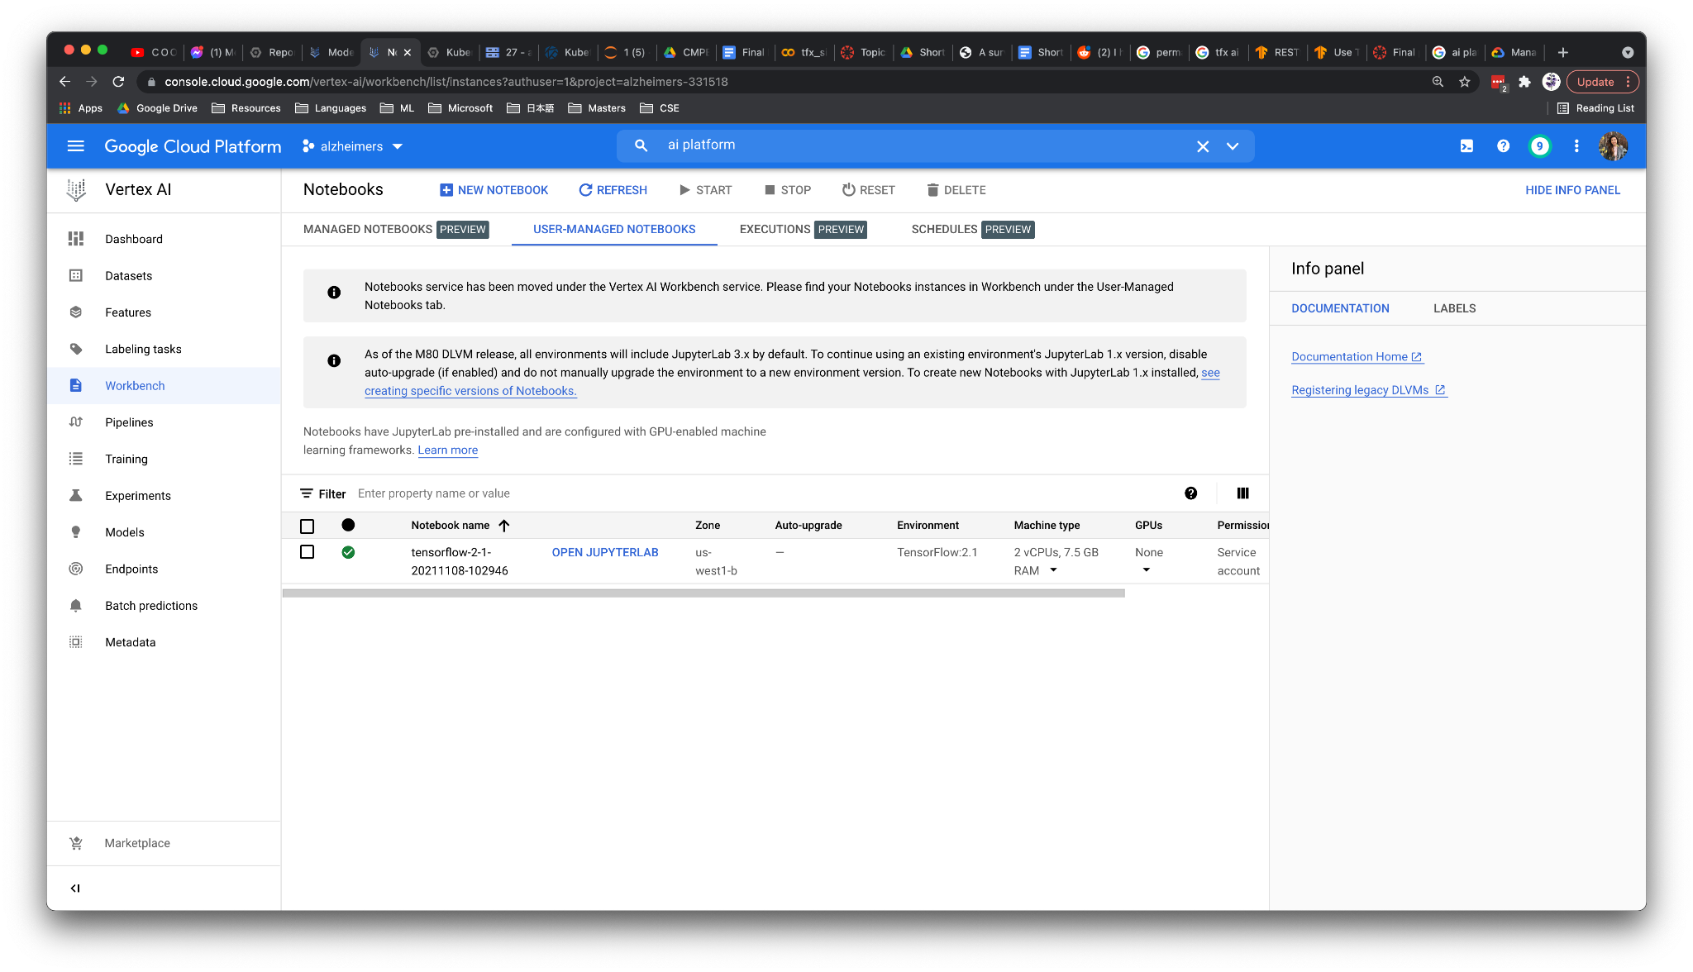
CREATE KUBERNETES CLUSTER
CREATE AI PLATFORM NOTEBOOK
KUBEFLOW SETUP

Slide 18
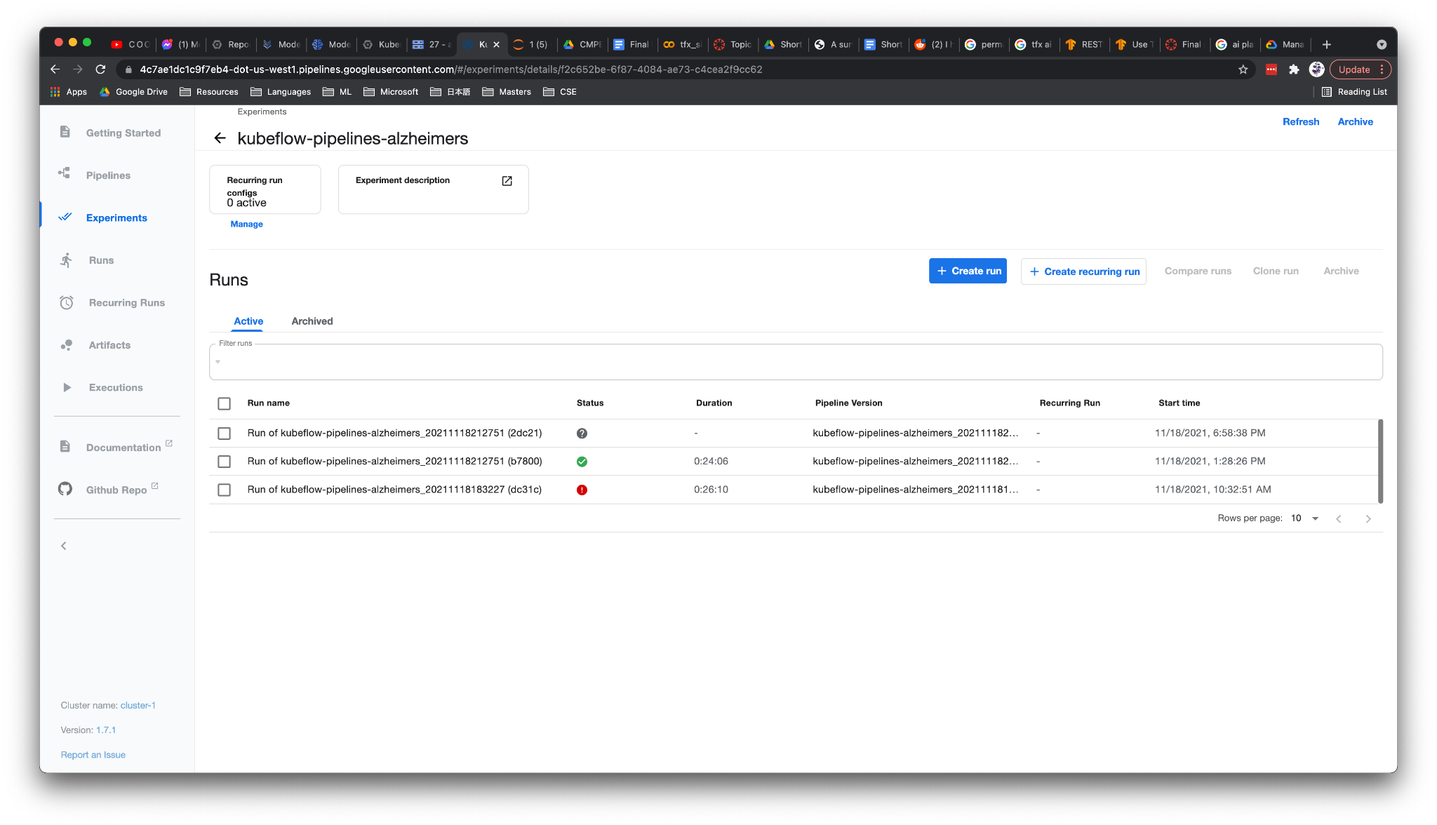
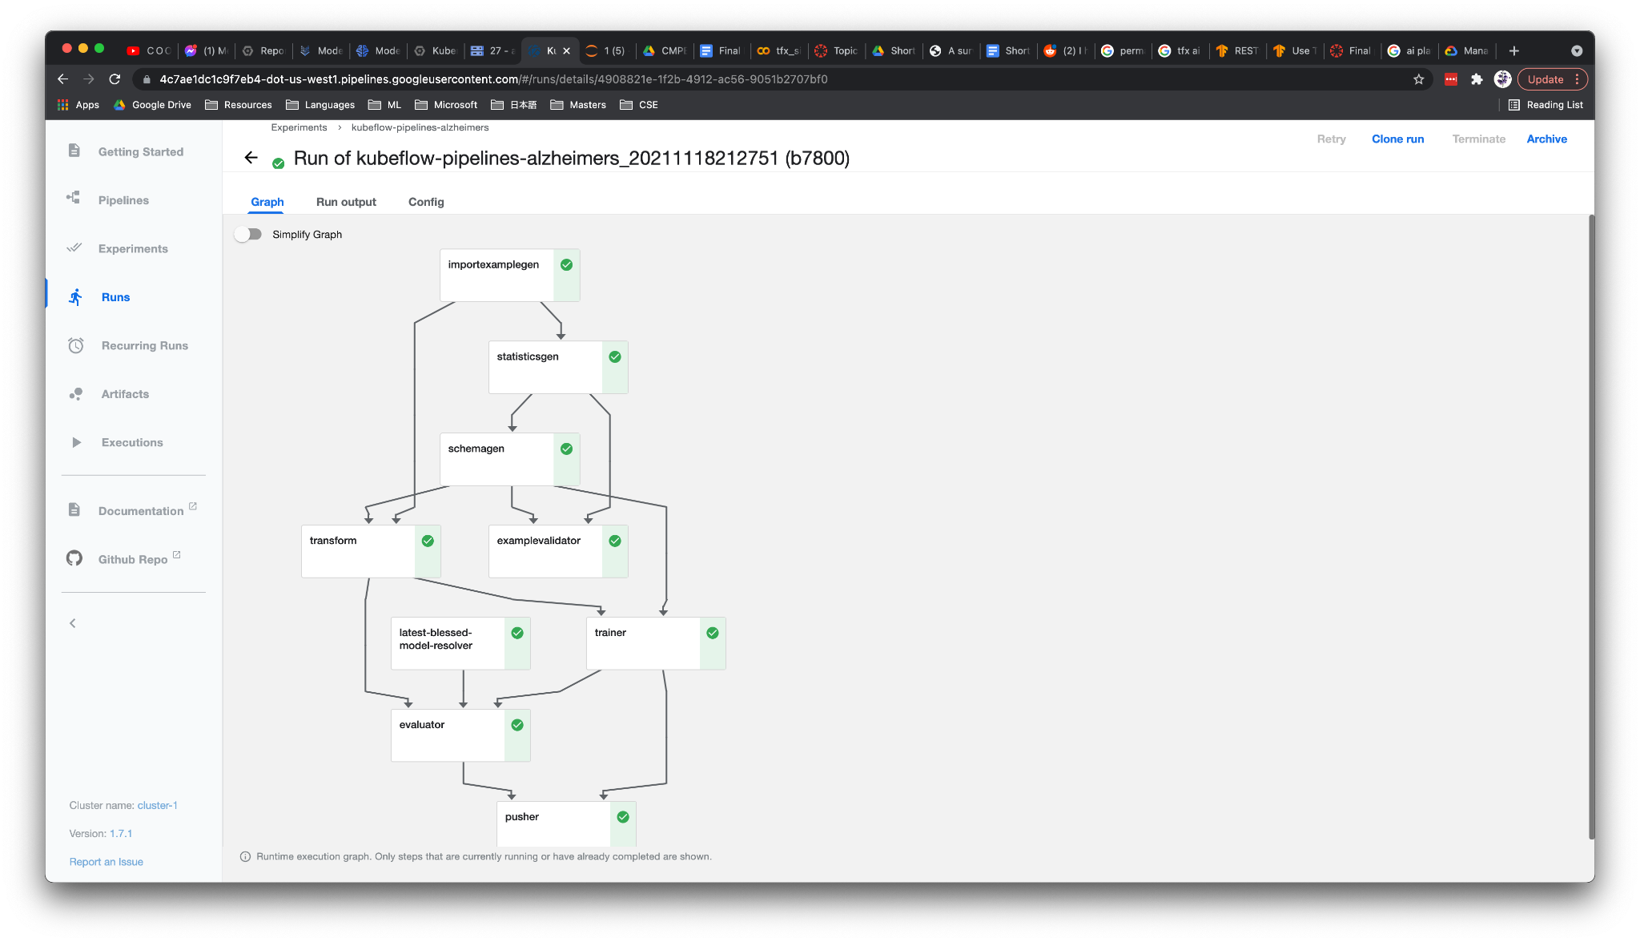

KUBEFLOW JOB PENDING
KUBEFLOW JOB SUCCEEDED
KUBEFLOW PIPELINE GRAPH
KUBEFLOW PIPELINE

Slide 19
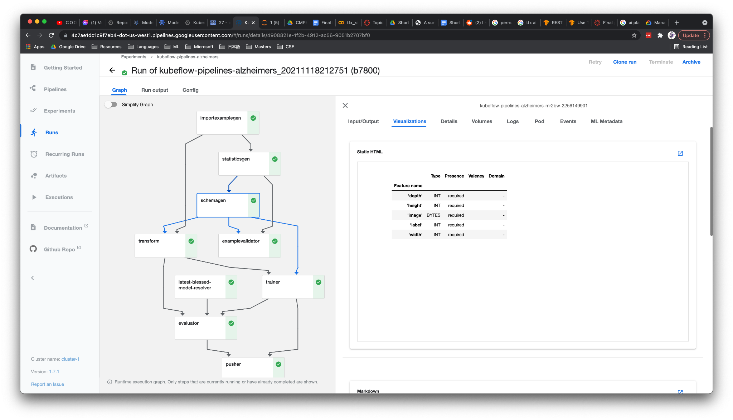
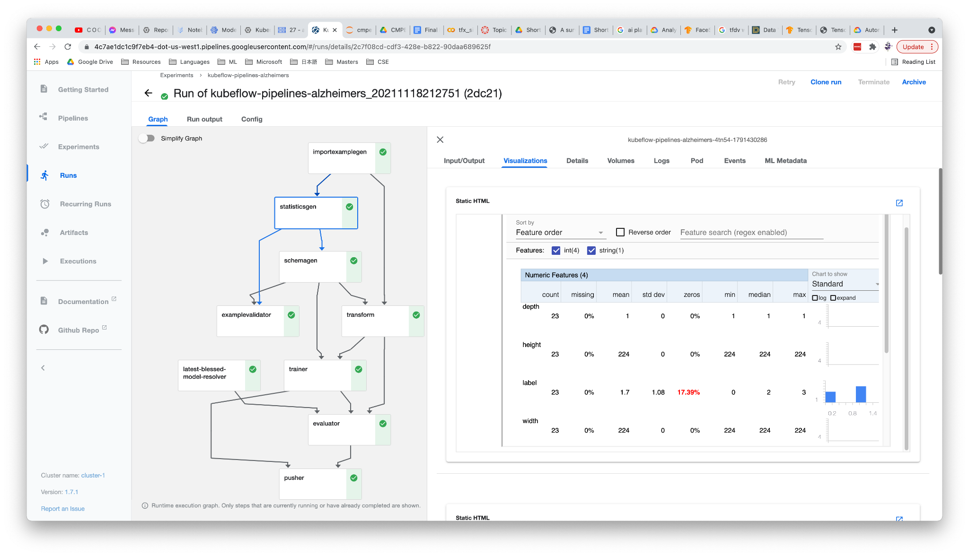
STATISTICS GEN ZOOMED IN
SCHEMA GEN ZOOMED IN
FEW KUBEFLOW PIPELINE STAGES ZOOMED IN

Slide 20

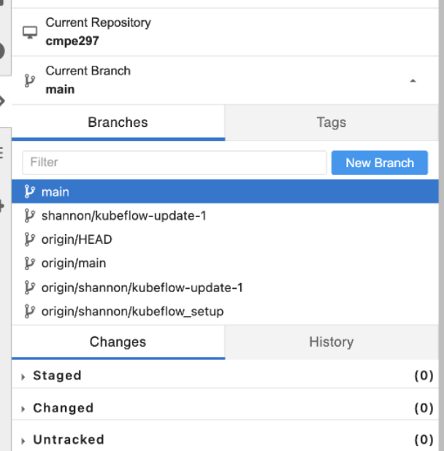
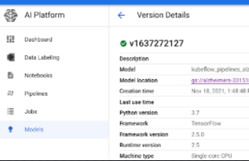
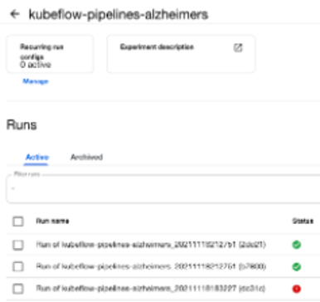
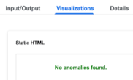
CI/ CD
MODEL VERSIONING, GATING
MONITOR PIPELINE
MONITOR SKEW, DRIFT, ANOMALY
ML OPS LEVEL 2 HIGH LEVEL CAPABILITIES

Slide 21
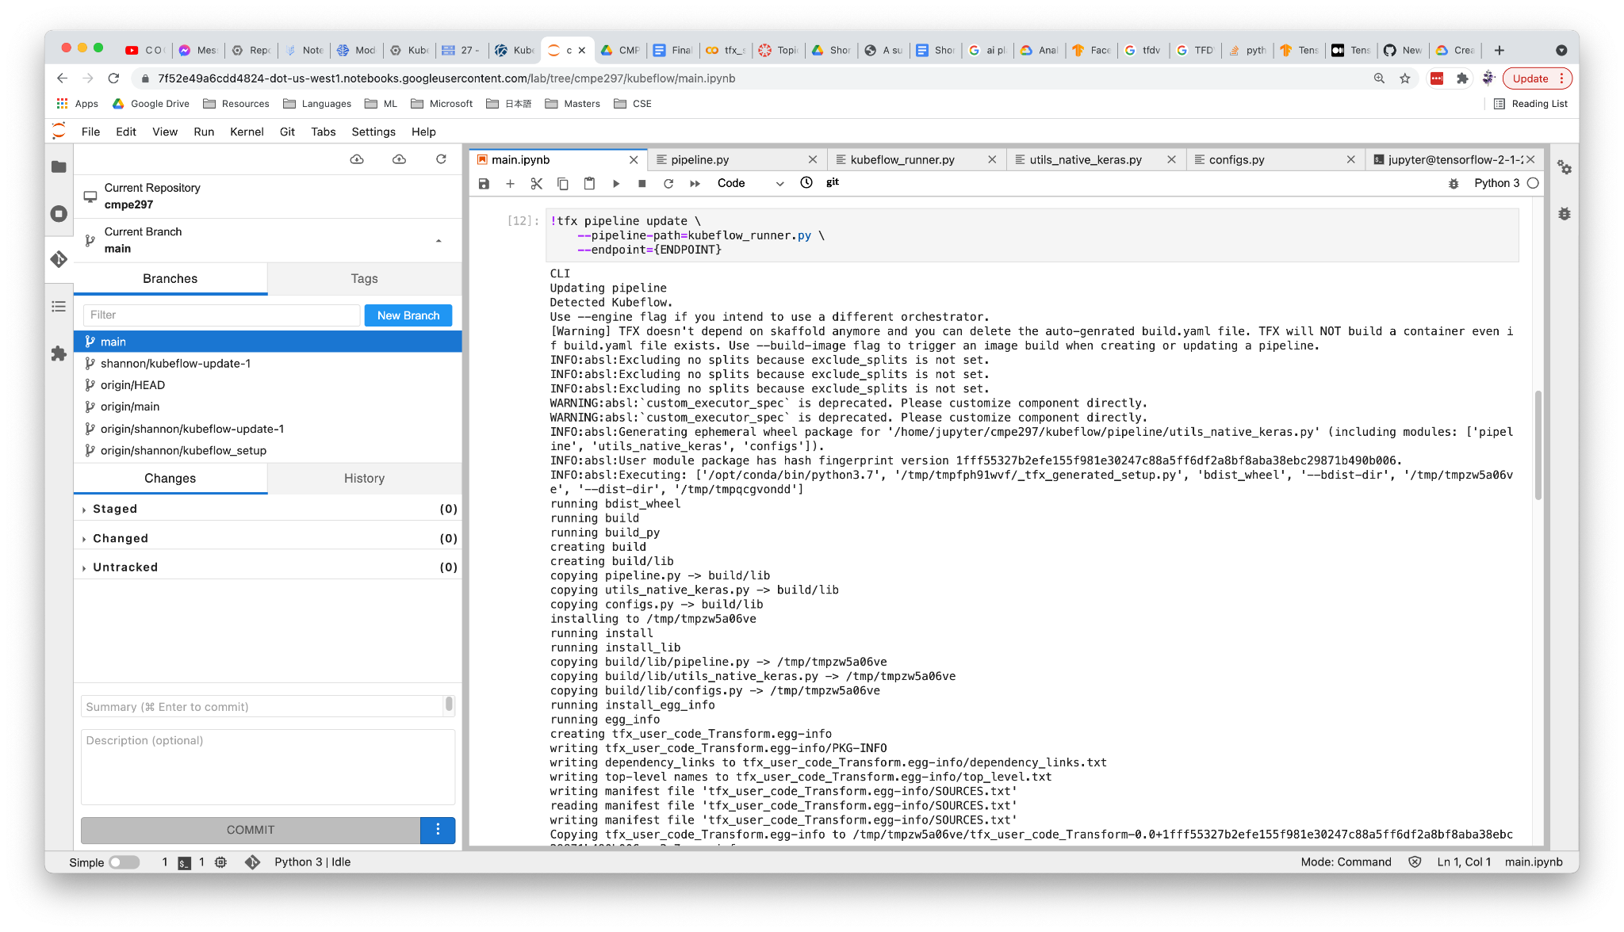
ML OP LEVEL 2 – CI/CD

Slide 22
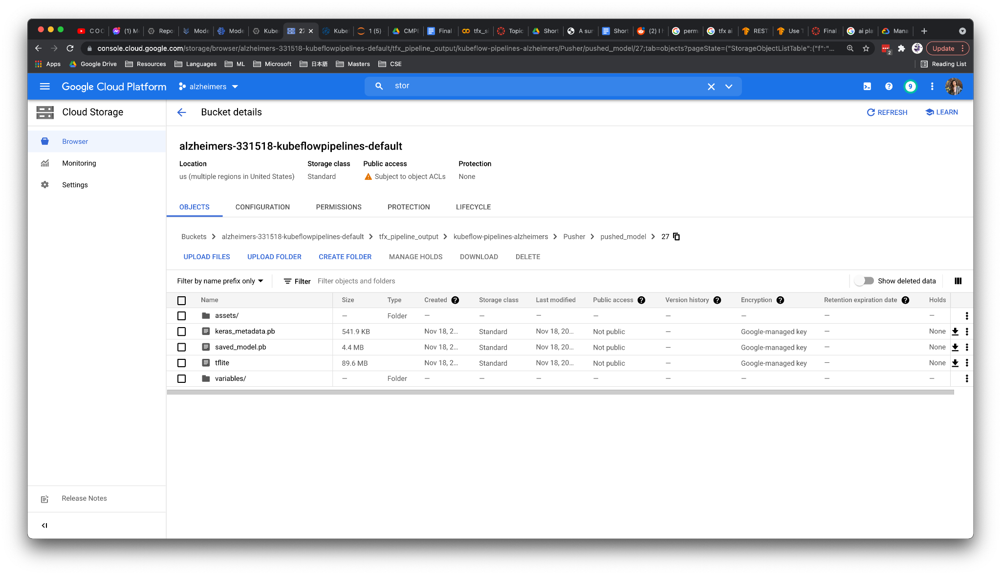
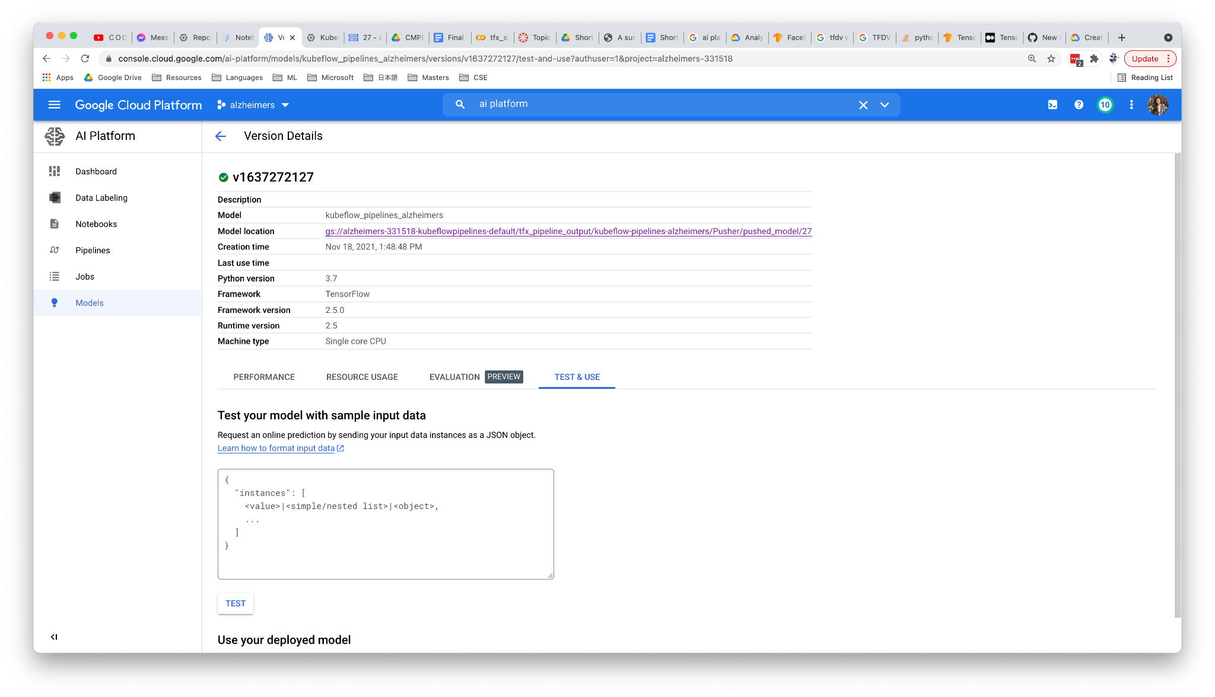
VERSIONED MODEL STORE
VERSIONED MODEL META DATA
ML OP LEVEL 2 – MODEL VERSIONING

Slide 23
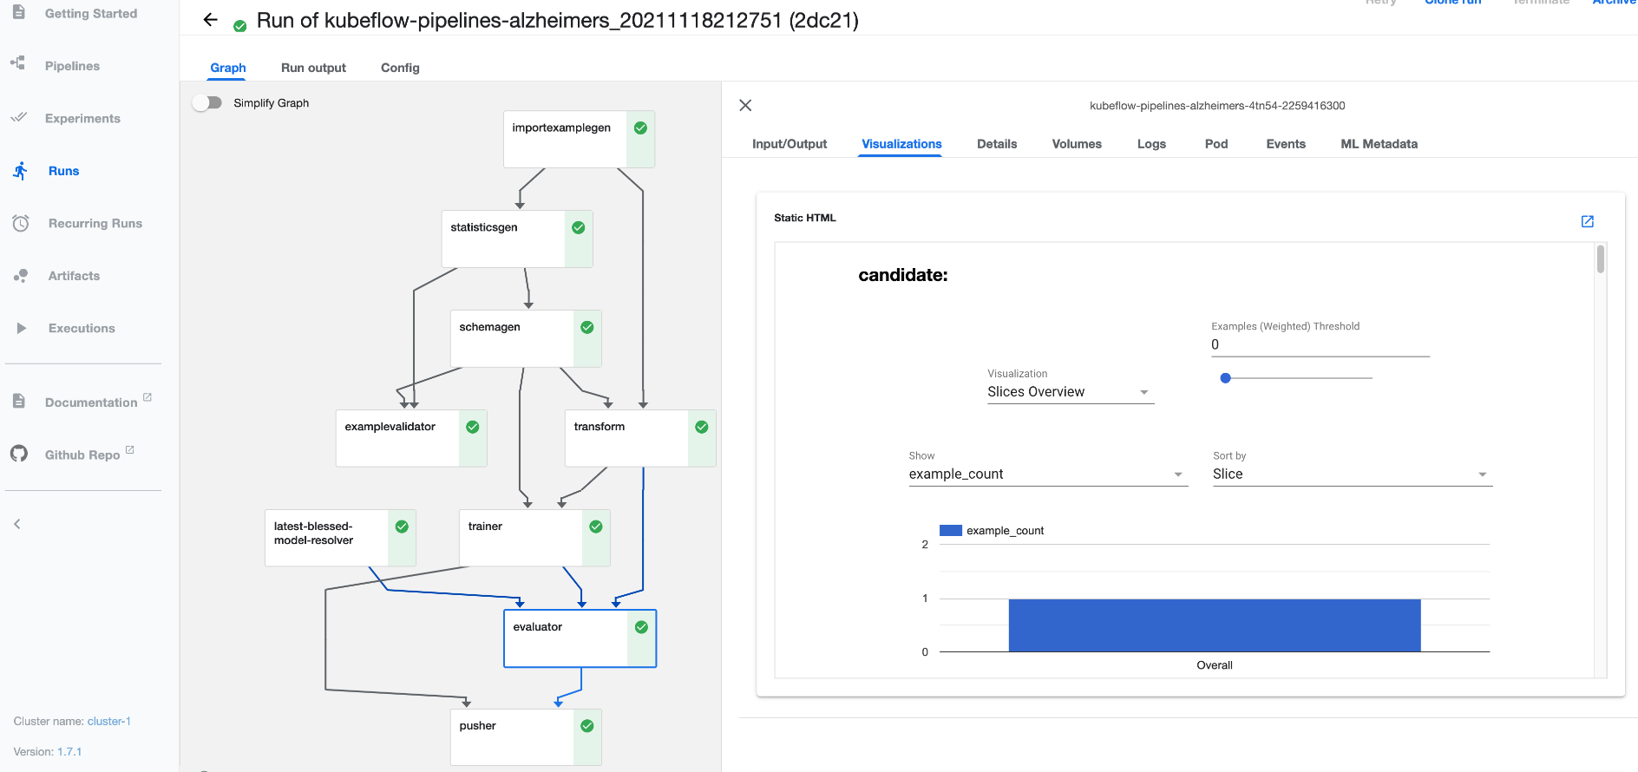
ML OP LEVEL 2 – MODEL GATING

Slide 24
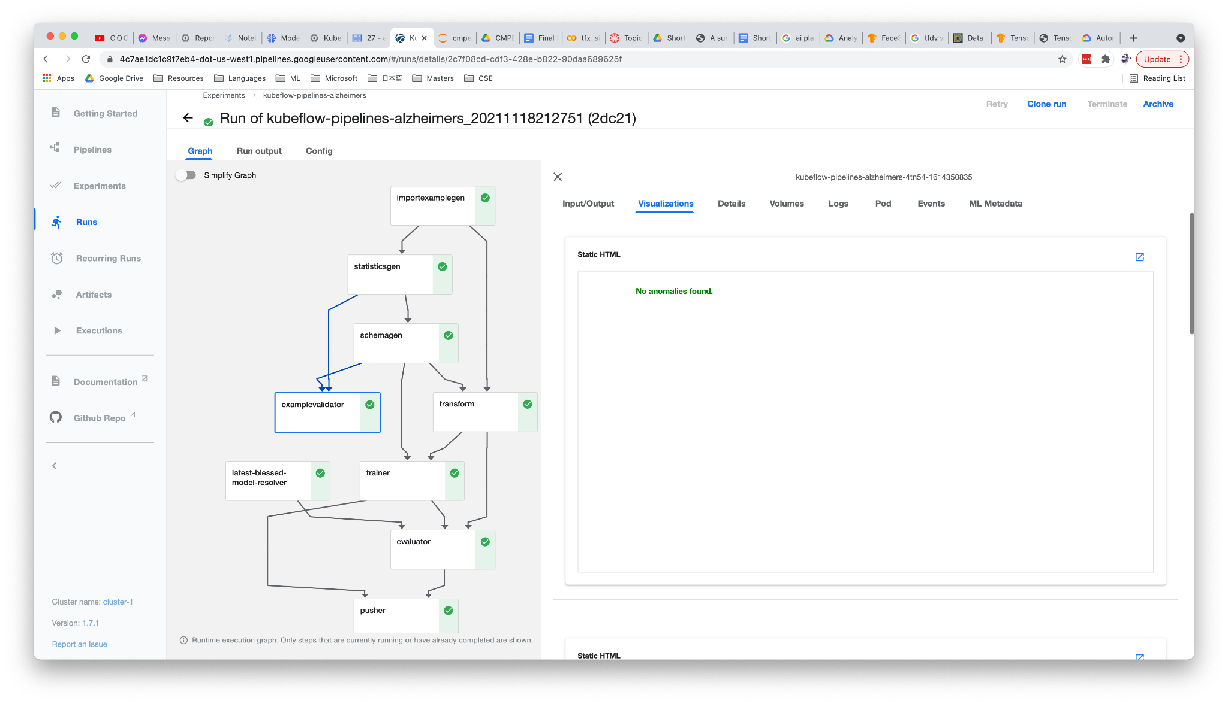
ML OP LEVEL 2 – MONITOR DATA SKEW, DRIFT, ANOMALY DETECTION

Slide 25
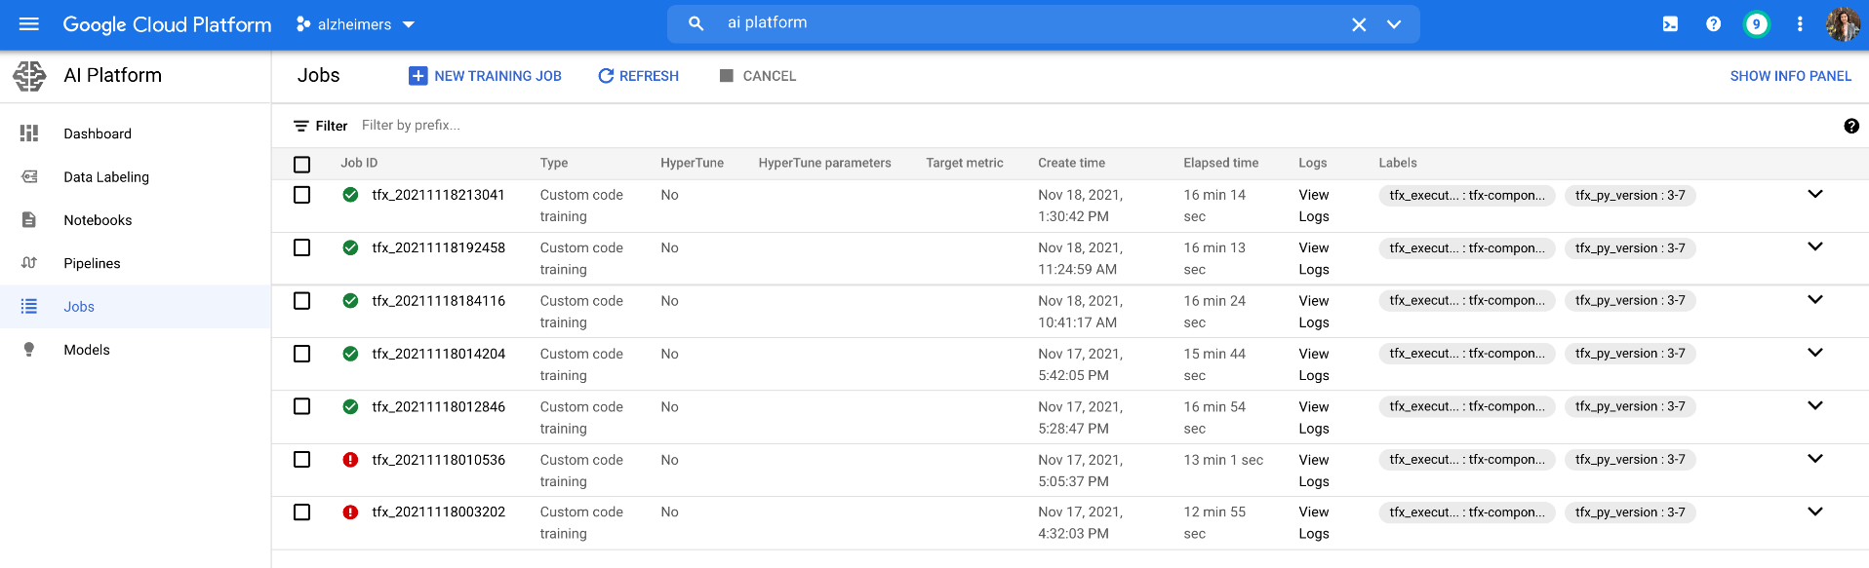
ML OP LEVEL 2 – MONITOR PIPELINE

Slide 26

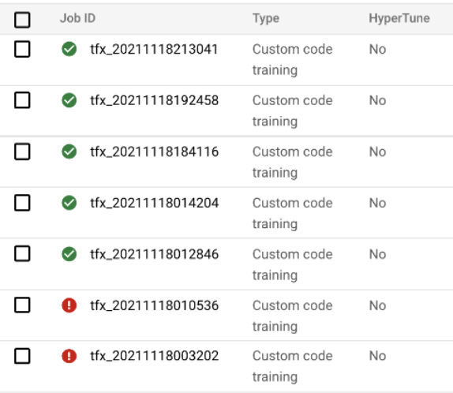
TFX FLOW
KUBEFLOW PIPELINES
GCP AI PLATFORM SUPPORT
DEMO LINK – TFX, KUBEFLOW, GCP

Slide 27

FLASK WEB APP HOSTED GCP APP ENGINE
MAKES GOOGLE API CALLS TO LATEST DEPLOYED MODEL ON GCP
DEMO LINK – FLASK APP ENGINE

Slide 28




CI/CD PIPELINE VIA GITHUB, TFX, KUBEFLOW INTEGRATION
BIG PICTURE
MODEL VERSIONING, MODEL GATING, MONITOR PIPELINE, MONITOR SKEW, DRIFT, ANOMALY VIA GOOGLE AI PLATFORM
REAL TIME PREDICTION VIA TENSORFLOW SERVING, GOOGLE API & FLASK WEB APPLICATION
HOSTED ON GCP APP ENGINE

Slide 29
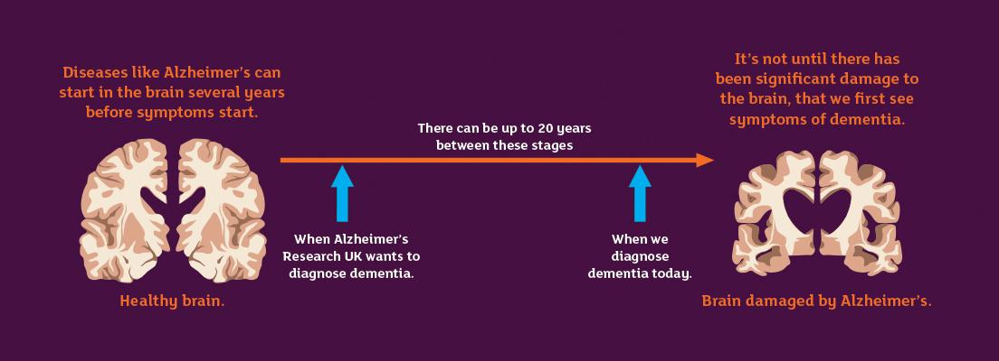
Pic Credits: Alzheimers Research UK
EARLY, ACCURATE DETECTION CRUCIAL TO MANAGE DISEASE

